Slide 1
Chapter 2: Project Management

Slide 2
Introduction
Project Management is the process of planning and controlling system development within a specified time at a minimum cost with the right functionality
A project is a set of activities with a specified beginning and end point meant to create a system that brings value to the business
Project Managers monitor and control all tasks and roles that need to be coordinated
Inception phase: generate a system request based on a business need or opportunity
Perform a feasibility analysis; revise the system request
Approve or decline the project
Notes:
What is a feasibility analysis?
What purpose does the feasibility analysis have?

Slide 3
Project Identification
Projects are driven by business needs
Identified by business people
Identified by IT people
(better yet) identified jointly by business and IT
The project sponsor believes in the system and wants to see it succeed
Normally this is a business person
Should have the authority to move it forward
Notes:
Give three examples of business needs for a system.
What is the purpose of an approval committee?
Who is usually on this committee?
Why should the system request be created by a businessperson as opposed to an IS professional?
Do IT People play a role in the system request?

Slide 4
Business Value
Tangible Value
Can be quantified and measured directly
Example: 2 percent reduction in operating costs
Intangible Value
We know it will add value & save time, but we may not be able to quantify or measure its benefits
Example: improved customer service
Notes:
What is the difference between intangible value and tangible value?
What are some examples of tangible values?
What are some examples of intangible values?
Who is ultimately responsible to determine the business value of the new system?

Slide 5
The System Request
A document that describes the reasons for and the value added from building a new system
Contains 5 elements:
Project sponsor: the primary point of contact for the project
Business need: the reason prompting the project
Business requirements: what the system will do
Business value: how will the organization benefit from the project
Special issues: Anything else that should be considered
Notes:
What is the purposes of the system request?
What are some examples of special issues?

Slide 6
Project Selection
Projects are approved, declined or delayed based on value added vs. risks
Project portfolio management
Goals:
Maximize cost/benefit ratio
Maintain an optimal mix of projects based on:
Risk
Size, cost & length of time to complete
Purpose, scope & business value
Limited resources require trade-offs
Selected projects enter the project management process
Notes:
What is the trade-offs that project managers must manage?

Slide 7
Project Management Tools
Aids in creating workplans
Identify all tasks, their sequence and estimate the time to complete each one
Work breakdown structures (WBS): a hierarchy of tasks to identify:
Duration of each task
Current status of each task
Task dependencies (shows which tasks must be completed before others can begin)
Gantt chart: a bar chart used to depict project tasks against a calendar.
PERT chart: a graphical network model used to depict the interdependencies between a project’s tasks.
Notes:
What does PERT stand for?
When & who developed it?
Which is older?
Which is the most commonly used for scheduling & process evaluation?
Are these tools mutually exclusive?

Slide 8
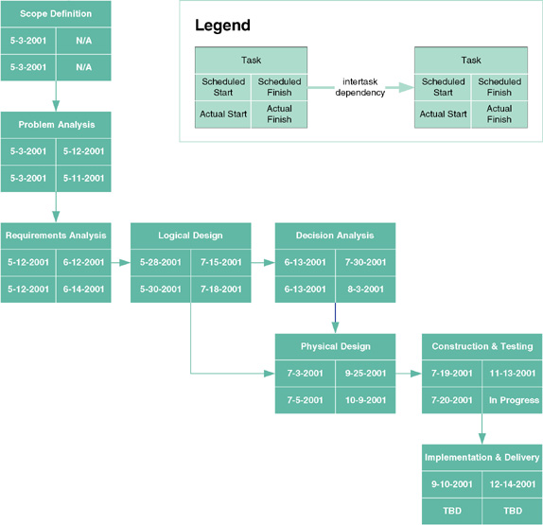
PERT Chart
Notes:
What does each box represent?
How do you know which tasks are dependent on each other?

Slide 9
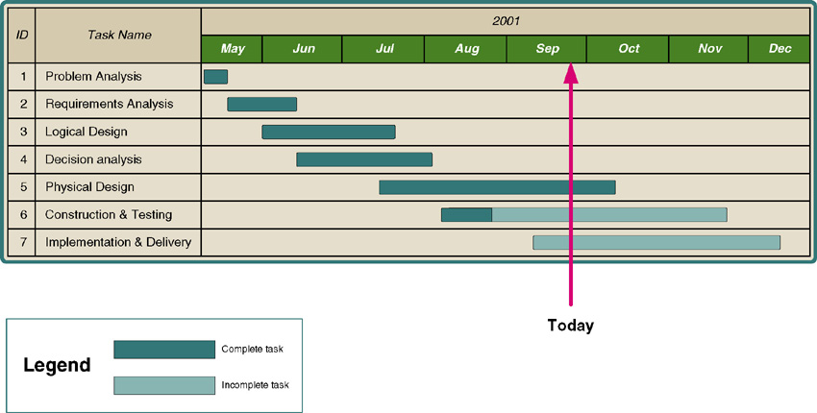
Gantt Chart
Notes:
Gantt charts more clearly show overlapping tasks (tasks that can be performed at the same time)
What do the shaded bars indicate?
What does a simple glance at the red line (to day) tell us?

Slide 10
Identify Tasks
Work breakdown structure (WBS) – a graphical tool used to depict the hierarchical decomposition of the project into phases, activities, and tasks.
Milestone – an event signifying the completion of a major project deliverable.
Notes:
A work breakdown structure may or may not include milestones. When do you stop “decomposing?”
Give some examples of the milestones?

Slide 11
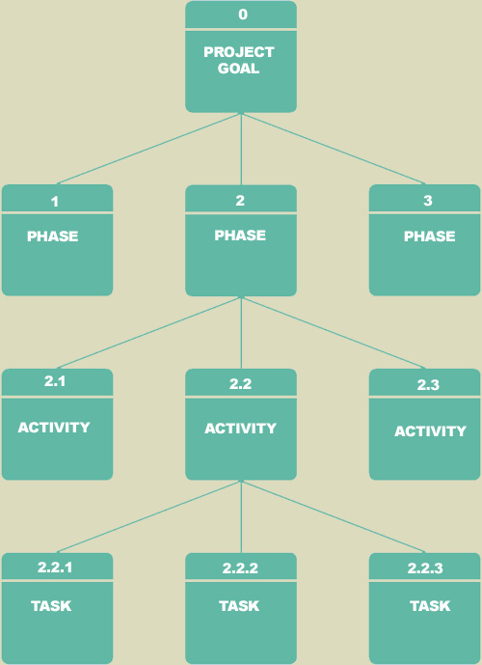
Identify Tasks
Notes:
A work breakdown structure represents a form of outlining and decomposition.

Slide 12
Estimate Task Durations
Elapsed time takes into consideration:
Efficiency - no worker performs at 100% efficiency
Coffee breaks, lunch, e-mail, etc.
Estimate of 75% is common
Interruptions
Phone calls, visitors, etc.
10-50%
Notes:
To determine how long it takes to complete a task we must realize we do not live in a 100% efficient world

Slide 13
Estimate Task Durations
1. Estimate the minimum amount of time it would take to perform the task – the optimistic duration (OD).
2. Estimate the maximum amount of time it would take to perform the task – the pessimistic duration (PD).
3. Estimate the expected duration (ED) that will be needed to perform the task.
4. Calculate a weighted average of the most likely duration (D) as follows:
D = (1 x OD) + (4 x ED) + (1 x PD) 6
OD
ED
PD
3.33 days = (1 x 2 days) + (4 x 3 days) + (1 x 6 days) 6
Notes:
Does everyone understand the formula?
Remember this is only Microsoft’s Project’s way of estimating different tools, use variants of this same basic approach.
What are some of the issues with this exercise?

Slide 14
Calculate the most likely duration for the following tasks:
Task Optimistic Pessimistic Expected
Duration Duration Duration
A 3 6 4
B 1 3 2
C 4 7 6

Slide 15
Specify Intertask Dependencies
Finish-to-start (FS)—The finish of one task triggers the start of another task.
Start-to-start (SS)—The start of one task triggers the start of another task.
Finish-to-finish (FF)—Two tasks must finish at the same time.
Start-to-finish (SF)—The start of one task signifies the finish of another task.
Notes:
What do project schedules depend on?
How do you usually depict or communicate inter-task dependencies?

Slide 16
Scope Management
Scope “creep”
Occurs after the project is underway
Results from adding new requirements to the project
Can have a deleterious effect on the schedule
Techniques to manage the project scope:
Identify all requirements at the outset
Allow only those changes deemed absolutely necessary
Carefully examine the impact of suggested changes
Delay some changes for “future enhancements”
Time boxing
Notes:
What is scope creep?
How can scope creep be managed?
What is timeboxing?
Why is timeboxing used?

Slide 17
Creating a “Jelled” Team
A team of people so strongly knit that the whole is greater than the sum of its parts
Characteristics of a jelled team:
Very low turnover rate
Strong sense of identity
A feeling of eliteness
Team vs. individual ownership of the project
Team members enjoy their work
Notes:
Which software methodology requires a “Jelled” Team?.
What Describe the skills that would be very important to have on any project.
What are some of the characteristics of a dysfunctional team?

Slide 18
Motivating People
Motivation is the greatest influence on performance
Monetary rewards usually do not motivate
Suggested motivating techniques:
20% time rule
Peer-to-peer recognition awards
Team ownership (refer to the team as “we”)
Allow members to focus on what interests them
Utilize equitable compensation
Encourage group ownership
Provide for autonomy, but trust the team to deliver
Notes:
What is the 20% rule?
What are the best ways to motivate a team?
What are the worst ways?

Slide 19
Handling Conflict
Preventing or mitigating conflict:
Cohesiveness has the greatest effect
Clearly defining roles and holding team members accountable
Establish work & communications rules in the project charter
Additional techniques:
Clearly define plans for the project
Make sure the team understands the importance of the project
Develop detailed operating procedures
Develop a project charter
Develop a schedule of commitments in advance
Forecast other priorities and their impact on the project
Notes:
List some techniques to reduce conflict.

Slide 20
Environment & Infrastructure Management
Environment—Choose the right set of tools
Use appropriate CASE tools to:
Increase productivity and centralize information (repository)
Utilize diagrams—more easily understood
Establish standards to reduce complexity
Infrastructure—Document the project appropriately
Store deliverables & communications in a project binder
Use Unified Process standard documents
Don’t put off documentation to the last minute
Notes:
What are some examples of standards?
What belongs in the project binder?
How is the project organized?

Slide 21
Suppose a proposed new financial reporting system for the AMF Biotech Corporation must be completed by the start of the next fiscal year in order to comply with new government regulations. This information should be included as part of the ____________ section of the system request.
a. business need
b. business value
c. business requirements
d. special issues or constraints
e. none of these

Slide 22
Why would an enterprise need a new system?

Slide 23
What is project management? What are the characteristics that define a project?

Slide 24
What are scope creep and feature creep?

Slide 25
How does scope creep and feature creep impact project success?

Slide 26
The three steps of project management are _____.
a. controlling the project, directing the project, and creating the work plan
b. creating the work plan, staffing the project, and controlling and directing the project
c. directing the project, creating the work plan, and naming the tasks
d. naming the tasks, creating the work plan, and completing the deliverables
e. setting the start date, estimating the time, and reading the actual time

Slide 27
Scope creep is only a minor factor in projects running over schedule, and every effort should be made to incorporate any changes into the present system if they would truly be beneficial. T / F

Slide 28
Compare and contrast Gantt and PERT charts

Slide 29
Are PERT & Gantt Charts usd in a mutually exclusive manner?

Slide 30
What does each box on a PERT Chart represent?

Slide 31
What does a simple glance at the center vertical line (red line, to day line) on a Ghantt Chart tell us?

Slide 32
Explain PERT Analysis.

Slide 33
What is the difference between intangible value and tangible value?

Slide 34
What are some examples of special issues in the system request?

Slide 35
Project Effort Estimation
Estimation involves trade-offs between functionality, time and cost
It is the process of assigning projected values for time and effort
Most accurate estimates come from experience
Use-case point method; based on:
Technical complexity factors (13)
Environmental factors (8)
Notes:
Does adding staff equate to shorter project times / more productivity?
Why do many projects end up having unreasonable deadlines?
How should a project manager react to unreasonable demands?.

Slide 36
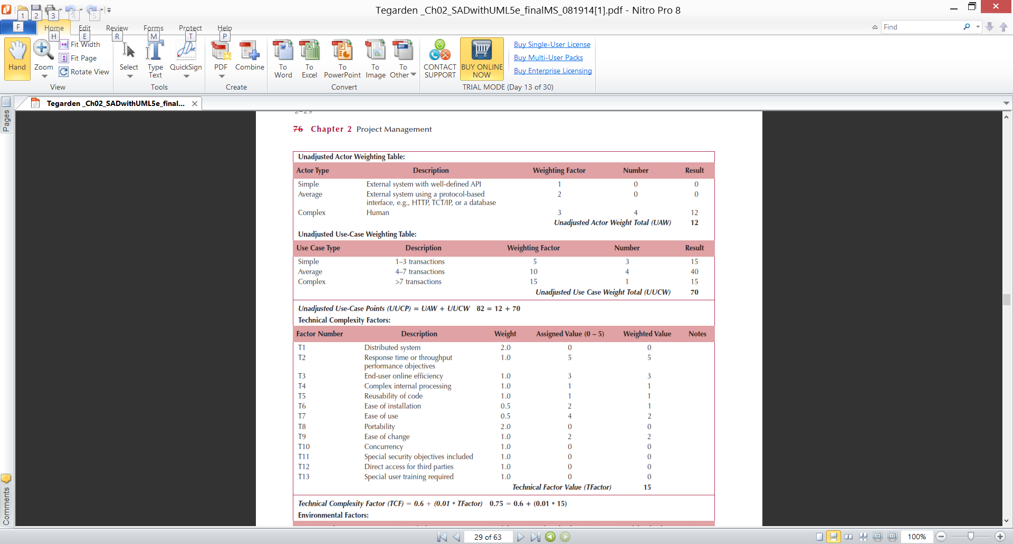
Use-case Estimation Example
Actors & Use-cases:
Notes:
What is a use-case point?
What is required before a use case point can be determined?
How is the first step in the process of using use case points?
What do we focus on after actors?

Slide 37
Use-case Estimation Example
Technical complexity factors:
Notes:
After we assess the manpower required by reviewing the types of actors & use cases, we turn our attention to the technical complexity of our proposed project.. Of the technical factors listed on this slide, which increase our staffing requirements the most

Slide 38
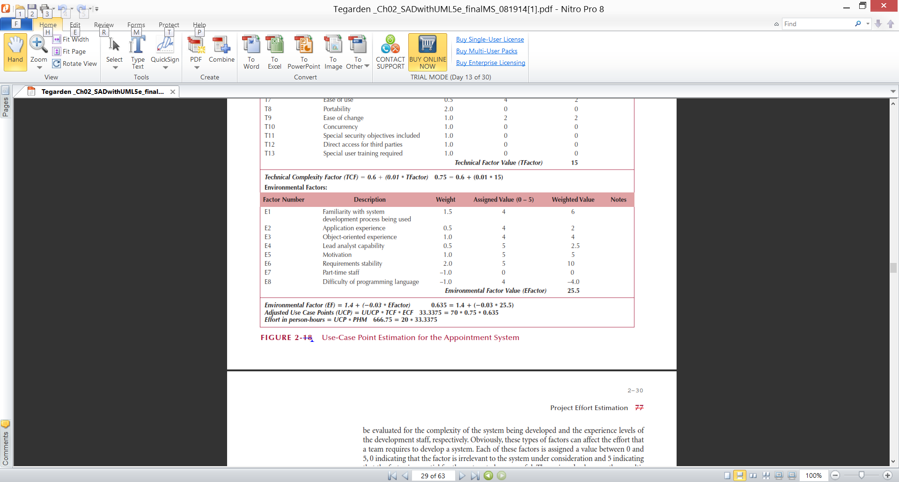
Use-case Estimation Example
Environmental factors & final estimate:
Notes:
Finally we determine the impact our project’s environmental factors will have on our staffing requirements & determine our manpower estimate. The slide tells us the weighted value of our environmental factors is 25.5. What are the other values that we will use to calculate our manpower estimate?

Slide 39
Manpower Estimate
Technical Complexity Factor (TCF)
TCF = .6 + (.01 * 15) = .75
Environmental Factor (EF)
EF = 1.4 + (-.03 * 25.5) = .635
Person Hour Multiplier = PHM
Number of E1 through E6 < 3 = 0 (A)
Number of E7 & E8 < 3 = 1 (B)
Number of E7 & E8 > 3 = 1 (C)
Notes:
How do you determine the value of the Person Hour Multiplier = PHM?
What happens if neither of the two apply?

Slide 40
Unadjusted Actor Weight = ACW = 12
Unadjusted Use Case Weight = UUCW = 70
Unadjusted Use Case Points = UUCP = UUCW + ACW = 82
Adjusted Use Case Points = (UCP) = UUCP x TCF x ECF
Adjusted Use Case Points = (UCP) = 82 x .75 x .635 = 39.0525
Staffing = Person Hours = PHM (20) x UCP (39.0525)
Staffing = Person Hours = 781.05

Slide 41
Evolutionary Work Breakdown Structures
Organized in a standard manner across all projects
Created in an incremental & iterative manner
Generality supports learning from past mistakes and successes
Unified Process:
Workflows are the major divisions
Workflows are decomposed along the phases
Phases are decomposed along the required tasks
Tasks are added as each iteration is completed
Notes:
What is an evolutionary WBS?

Slide 42
Feasibility Analysis
Is this project feasible?
What are the risks?
Can these risks be overcome?
Major components:
Technical feasibility (Can we build it?)
Economic feasibility (Should we build it?)
Organizational feasibility (Will they use it?)
Notes:
What is the purposes of the feasibility analysis?
Who is responsible to draft / approve the feasibility analysis?
How is it used in the project selection process?

Slide 43
Technical Feasibility
Identify risks in the following areas:
The functional area: Are analysts familiar with this portion of the business?
The technology: Less familiarity generates more risk
Project size: Large projects have more risk
Compatibility: Difficult integration increases the risk
Notes:
Technical feasibility focuses on the ability of the organization to
successfully develop the proposed system. What are some of
the areas we examining when conducting a technical
feasibility analysis?
What are some techniques / tools that can be used to help prepare a technical feasibility analysis?

Slide 44
Organizational Feasibility
Will the users accept the system?
Is the project strategically aligned with the business?
Conduct a stakeholder analysis
Project champion(s)
Organizational management
System users
Others
Notes:
What do you focus on during an organizational feasibility analysis?
All the candidate solutions should be analyzed according to all of the above criteria. Will any candidate be “most feasible” according to all of the criteria? -

Slide 45
What is the purposes of the feasibility analysis?

Slide 46
_____ is the process of examining the technical, economic, and organizational pros and cons of developing a new system.
a. Committee approval
b. Feasibility analysis
c. Functionality determination
d. Risk analysis
e. System request

Slide 47
Which of the following factors could be included in a technical risk assessment?
a. Cost of a new Web server
b. Cost of hiring a Webmaster
c. No previous experience with Java
within the IS department
d. Some fear of job loss among order
entry department personnel
e. all of these

Slide 48
Traditional Work Breakdown Structures tend to
a. focus on the design of the system as oppose
to the needs of the current phase and
iteration
b. force too many levels of detail early on for
large project and they tend to allow too few
level of detail for small projects
c. be too specific for the project and difficult
to compare across projects
d. all of these
e. none of these

Slide 49
Creating a work plan requires three steps: identify the tasks that need to be accomplished, estimate the time that it will take to complete the tasks, and record the task completion time in a Gantt Chart. T / F

Slide 50
What is a work breakdown structure?
Why is it important to project planning?

Slide 51
When performing an operational feasibility analysis, list the three goals that help measure the desirable useable) interface.

Slide 52
A feasibility analysis includes whether the project has been permitted by the CIO of the company. T / F

Slide 53
Cost-Benefit Analysis Techniques
Costs:
Development costs are one time costs that will not recur after the project has been completed.
Operating costs are costs that tend to recur throughout the lifetime of the system. Such costs can be classified as:
Fixed costs — occur at regular intervals but at relatively fixed rates.
Variable costs — occur in proportion to some usage factor.
Benefits:
Tangible benefits are those that can be easily quantified.
Intangible benefits are those benefits believed to be difficult or impossible to quantify.
Notes:
What are examples of fixed costs?
What are examples of variable costs?..
What can we say about benefits in general?.
Who can give me some examples of tangible benefits?
Who can give me some examples of intangible benefits?
How do you quantify good will?

Slide 54
Three Popular Techniques to Assess Economic Feasibility
Payback Analysis
Return On Investment
Net Present Value
The Time Value of Money is a concept that should be applied to each technique. The time value of money recognizes that a dollar today is worth more than a dollar one year from now.
Notes:
Does the time value of money apply to benefits or costs?
When do we apply the time value of money concept to our cost benefit analysis?

Slide 55
Present Value Formula
Present value – the current value of a dollar at any time in the future.
PV_{n} = 1/(1 + i)^{n}
Where n is the number of years and i is discount rate
Interest rate – a percentage similar to interest rates that you earn on your savings.
In most cases the discount rate for a business is the opportunity cost of being able to invest money in other projects or investments
Notes:
What does the present value do?
Who determines the interest rate?
If a company sets a 10% discount rate and my project requires a $1,000 investment now with a promise of a $1,300 return in 3 years, is it economically feasible?

Slide 56
Payback Analysis
Break Even Point
Payback analysis – a technique for determining if and when an investment will pay for itself.
Payback period – the period of time that will lapse before accrued benefits overtake accrued and continuing costs.
Notes:
Systems development costs are incurred long before any benefits accrue. Therefore it will take time for the benefits to overtake the costs. Who can describe payback analysis in their own words?
What metric do we use for the payback period?

Slide 57
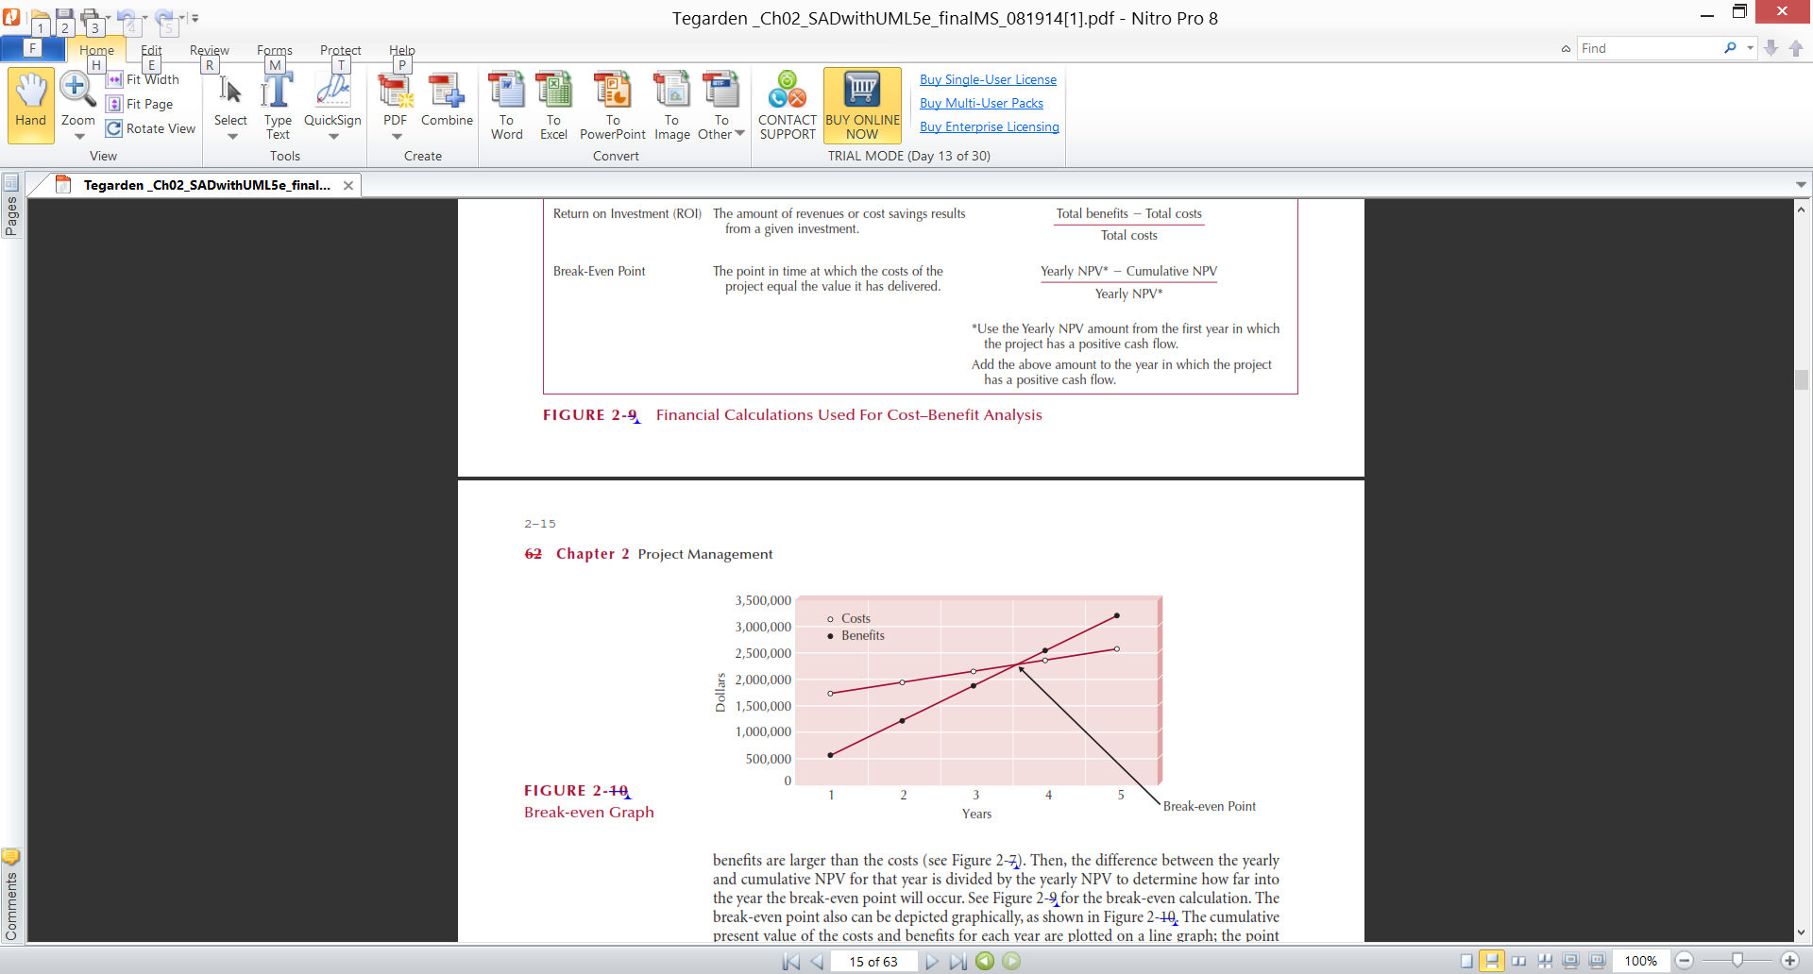
Example Break-Even Point
Notes:
What happens at the break even point?
If an enterprise invests a $1mil in year 1 a $1/2 mil in year #2 & $1/4 mil in year #3 when it starts to accrue benefits from the system and during the last month of year 3 accrues $1 ¾ mil. What is the enterprises beak even point?

Slide 58
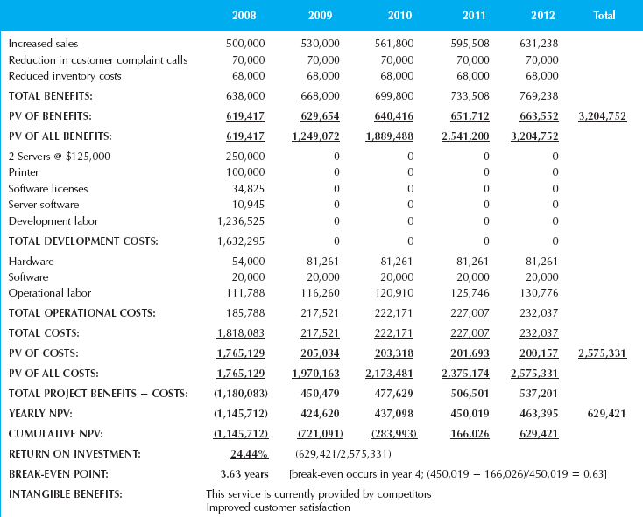
Example Cost-Benefit Analysis
Notes:
What is the total cost for this project?
What is the benefits derived?
What is the time adjusted costs of the benefits derived)
What is the payback period?
What is the relationship between costs & benefits at 3.63 years?

Slide 59
Return-on-Investment (ROI)
Return-on-Investment (ROI) analysis – a technique that compares the lifetime profitability of alternative solutions.
The ROI for a solution or project is a percentage rate that measures the relationship between the amount the business gets back from an investment and the amount invested.
Lifetime ROI = (estimated lifetime benefits – estimated lifetime costs) / estimated lifetime costs
Annual ROI = lifetime ROI / lifetime of the system
Notes:
A second technique to assess economic feasibility is ROI. What metric to we use for ROI?
Once again, lifetimes might have a maximum duration per company policy and all costs & benefits must be time adjusted. Using our prior example, what is this project’s life time ROI?
What is its annual ROI?
What value does annual ROI have?
What happens if we do not adjust costs?

Slide 60
Net Present Value (NPV) Analysis
Net present value – analysis technique that compares annual discounted costs and benefits of alternative solutions.
Net present value =
($3,204,752 – $2,575,331)
= $629,421
Notes:
How do you calculate the Net Present Value?
How do we translate this example?

Slide 61
How do you quantify good will?

Slide 62
When do we apply the time value of money concept to our cost benefit analysis?

Slide 63
What does the present value calculation do?

Slide 64
What happens at the new system’s break even point?

Slide 65
What are the two categories of cost? Give some examples of each.

Slide 66
A limitation of a formal cost-benefits analysis is that it contains the costs and benefits for just one year. T /F

Slide 67
Development costs that are examined during feasibility analysis include costs for software licenses and software upgrades. T /F

Slide 68
Compare and contrast the Cash Flow, Return on Investment, and Net Present Value methods of assessing a project's economic feasibility.

Slide 69
Identify the seven steps involved in conducting the economic feasibility.

Slide 70
Explain the role of the project champion.

Slide 71
Explain the concept of timeboxing.

Slide 72
Mini Case
Read Mini Case #1
Page #83 in the Text

Slide 73
What questions does Harry need to have answered about his project.

Slide 74
A list of questions that Harry needs to have answered about his project.
What is your specific objective for this Internet system?
What specific things do you want customers to do?
Revenue estimates? Their Accuracy?
Target budget?
Outside help available?
Potential adverse response by the storeowners?

Slide 75
Mini Case
Read Mini Case #2
Page #83 & #84 in the Text

Slide 76
What is the expected value of the annual revenue increase of each row?

Slide 77
Mini Case
Read Mini Case #3
Page #84 in the Text

Slide 78
What are some examples of strategies that may be helpful to Emily?

Slide 79
Mini Case
Read Class Handout

Slide 80
What four innocuous incidents combine to produce the “perfect storm”?
What are some of the project’s risks?
Some organizational factors increase a project’s likelihood of success. Identify these “facilitators” for the Green Project.
Other organizational factors decrease a project’s likelihood of success. Identify these “barriers” for the Green Project.
Outline the things that McCann needs to do right away.

Slide 81
What four innocuous incidents combine to produce the “perfect storm”?

Slide 82
What are some of the project’s risks?

Slide 83
Some organizational factors increase a project’s likelihood of success. Identify these “facilitators” for the Green Project.

Slide 84
Other organizational factors decrease a project’s likelihood of success. Identify these “barriers” for the Green Project.

Slide 85
Outline the things that McCann needs to do right away.

Slide 86
What is a feasibility analysis?

Slide 87
What purpose does the feasibility analysis have?

Slide 88
Who is ultimately responsible to determine the business value of the new system?

Slide 89
A work breakdown structure “decomposes” your systems into manageable tasks. When do you stop composing?

Slide 90
When do you stop “decomposing?” When the activity is divided into manageable tasks, in general, a rule of thumb commonly used is 40 hours

Slide 91
How do you usually depict or communicate inter-task dependencies?

Slide 92
Which software methodology requires a “Jelled” Team?

Slide 93
What are some of the characteristics of a dysfunctional team?

Slide 94
What is the 20% rule?

Slide 95
Does adding staff equate to shorter project times / more productivity?

Slide 96
What are some techniques / tools that can be used to help prepare a technical feasibility analysis?

Slide 97
What is the purposes of the feasibility analysis?

